Slide 1


Roye Bustan
11/15/23

Slide 2

Outline
Executive Summary
Introduction
Methodology
Results
Conclusion
Appendix

Slide 3
Executive Summary
Summary of methodologies
Collecting Data through:
API call to Space X Data
Web Scraping (beautiful soup)
Data Wrangling/Organization
Exploratory Data Analysis using:
SQL
Data Visualization
Interactive Visual Analytics using folium
Machine Learning Predictions on Associated Dataframes.
Summary of all results
Exploratory Data Analysis Results
Interactive Analytics in Jupyter Notebooks
Predictive Analytics result from ML

Slide 4
Introduction
Project background and context
In this capstone project, our objective is to predict the successful landing of the Falcon 9 first stage. SpaceX prominently features Falcon 9 rocket launches on its website, advertising a cost of 62 million dollars. In comparison, other providers charge upwards of 165 million dollars for each launch. The substantial cost savings with SpaceX can be attributed to their innovative approach of reusing the first stage of the rocket. Consequently, determining the likelihood of a successful first stage landing becomes crucial in assessing the overall cost of a launch.
Problems you want to find answers
What factors determine when a rocket lands successfully?
What conditions need to be in place to ensure a successful landing program?
Can these features be used to not only analyze trends but predict future landings?

Slide 5

Section 1

Slide 6
Methodology
Executive Summary
Data collection methodology:
Data was collected using the SpaceX API and Web Scraping from wikipedia page.
Perform data wrangling
One-hot encoding was applied to categorical features
Perform exploratory data analysis (EDA) using visualization and SQL
Perform interactive visual analytics using Folium and Plotly Dash
Perform predictive analysis using classification models
How to build, tune, evaluate classification models

Slide 7
Data Collection
The data was collected using the following:
Data collection was done using get request to the SpaceX API.
Next, we formatted the response as a Json using .json() function call and turn it into a pandas dataframe using .json_normalize().
We then cleaned the data, checked for missing values and filled in missing values with averages or N/A’s.
We performed web scraping from Wikipedia as well for Falcon 9 launch records with BeautifulSoup; taking information as HTML table, parse the table and convert it to a pandas dataframe.

Slide 8
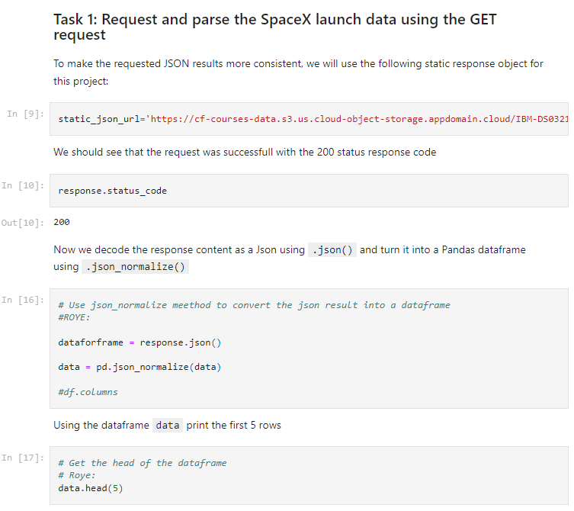
Data Collection – SpaceX API
Used a simple get request along with a response status code. Also normalized the data to get a cleaner dataframe.
GitHub Notebook URL: https://github.com/Rbustan0/Rbustan-Coursera-IBM-Data-Science-Capstone/blob/main/WEEK1_%20DATACOLLECTION_jupyter-labs-spacex-data-collection-api.ipynb

Slide 9
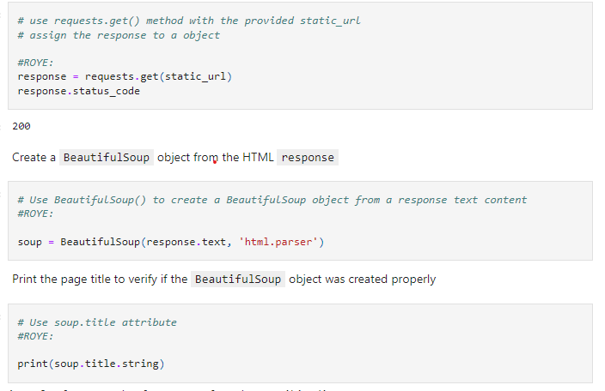
Data Collection - Scraping
Requested Falcon9 Launch Wiki page from its URL, then extracted all column/variable names from the HTML table header, and finally created a dataframe by parsing the launch HTML tables.
Github Notebook Link: https://github.com/Rbustan0/Rbustan-Coursera-IBM-Data-Science-Capstone/blob/main/WEEK1_DATACOLLECTION_SOUP_jupyter-labs-webscraping.ipynb

Slide 10
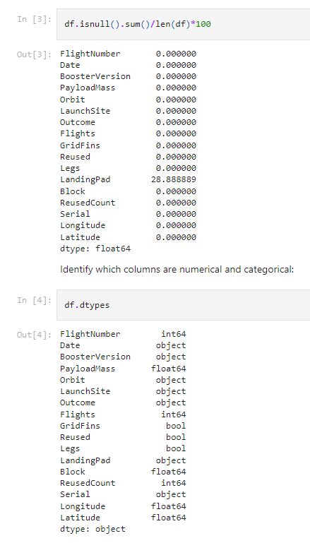
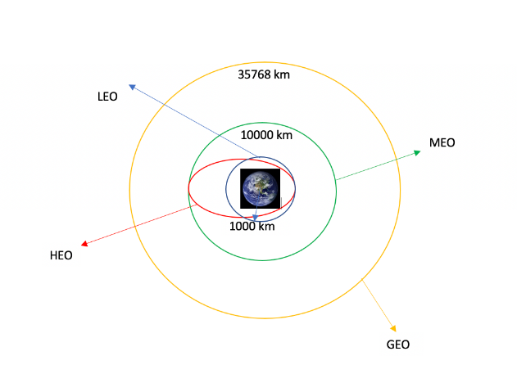
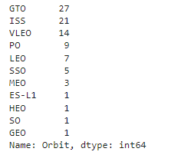
Data Wrangling
We took several cases where boosters did not land successfully and converted those values into an extra col of binary values, checked data was being passed through correctly by checking its type, calculated number of missing values from the scraped data, and replaced empty values with averages.
We did this in conjunction of calculating number of orbit occurrences and used that to review our landing outcomes to determine success rates of certain landings.
GitHub Notebook URL: https://github.com/Rbustan0/Rbustan-Coursera-IBM-Data-Science-Capstone/blob/main/WEEK1_Data%20wrangling.ipynb

Slide 11
EDA with Data Visualization
Made SNS scatterplots/bubbleplots that visualizes the relationship between flight number and Launch Site, payload and launch site, Orbit success classifications based on flight numbers, and payload and orbit on class.
A SNS bar chart that visualizes the relationship between success rate of each orbit type.
A SNS line plot that visualizes success rate over the years.
Created dummy variables and casted numeric columns to float64 for features engineering Later on.
GitHub Notebook URL: https://github.com/Rbustan0/Rbustan-Coursera-IBM-Data-Science-Capstone/blob/main/WEEK2_SNS_eda-dataviz.ipynb.jupyterlite.ipynb

Slide 12
EDA with SQL
Using Postgresql: Selected unique records of landing sites using SQL displaying/making averages on payloads generically and by booster versions.
Also tracked and created queries that display unique records such as dates of successful landings and names of boosters associated with successful landings as well as their counts.
GitHub Jupyter Notebook URL:
https://github.com/Rbustan0/Rbustan-Coursera-IBM-Data-Science-Capstone/blob/main/WEEK2_eda-sql-coursera_sqllite.ipynb

Slide 13
Build an Interactive Map with Folium
Added all launch sites on a folium geographic map using a blue Folium Circle object with marker objects.
Assigned feature landing outcomes to true/false binary values
Color labeled clusters were made as well.
Distance between various objects and launch sites were measured as well such as railways, highways, and coastways.
Summarize what map objects such as markers, circles, lines, etc. you created and added to a folium map
GitHub Jupyter Notebook URL: https://github.com/Rbustan0/Rbustan-Coursera-IBM-Data-Science-Capstone/blob/main/WEEK3_lab_jupyter_launch_site_location.jupyterlite.ipynb

Slide 14
Build a Dashboard with Plotly Dash
Dashboard features (time adjustable):
Plotted pie charts with total launches by certain sites
scatter graphs that depict outcomes vs payload mass
We wanted users to be able to compare total launches with their expected output in payload mass to show comparisons of outcomes and trends
Github Plotly Dash Lab: https://github.com/Rbustan0/Rbustan-Coursera-IBM-Data-Science-Capstone/blob/main/WEEK3_spacex_launch_dash.csv

Slide 15
Predictive Analysis (Classification)
Objective was to perform EDA to determine Training Labels:
created columns for classes
standardized the data
split into training data and test data
Used and compared different machine learning models to tun hyperparameters (GridSearchCV).
Tuned features (feature engineering) and algorithms to determine and weigh accuracy between different machine learning models stacked against each other in the lab.
Results determined that our issue required a classification model.
GitHub Jupyter Notebook URL: https://github.com/Rbustan0/Rbustan-Coursera-IBM-Data-Science-Capstone/blob/main/WEEK4_SpaceX_Machine_Learning_Prediction_Part_5.jupyterlite.ipynb

Slide 16
Results
Exploratory data analysis results
Interactive analytics demo in screenshots
Predictive analysis results

Slide 17

Section 2

Slide 18
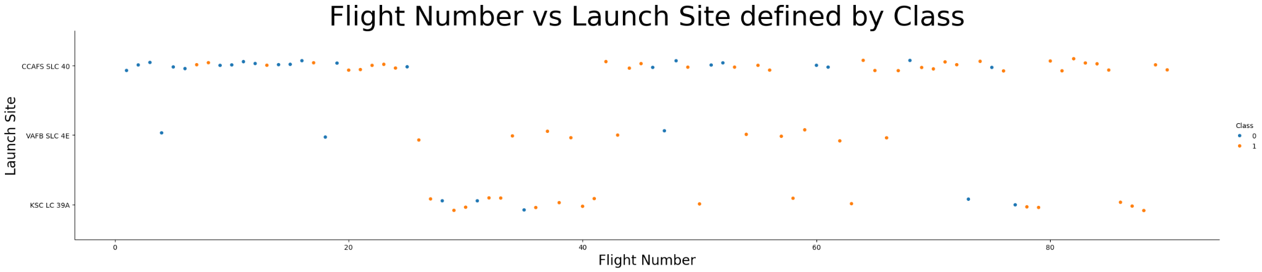
Flight Number vs. Launch Site
This study depicts that success return is higher when more flights are tallied at the same launch site.

Slide 19
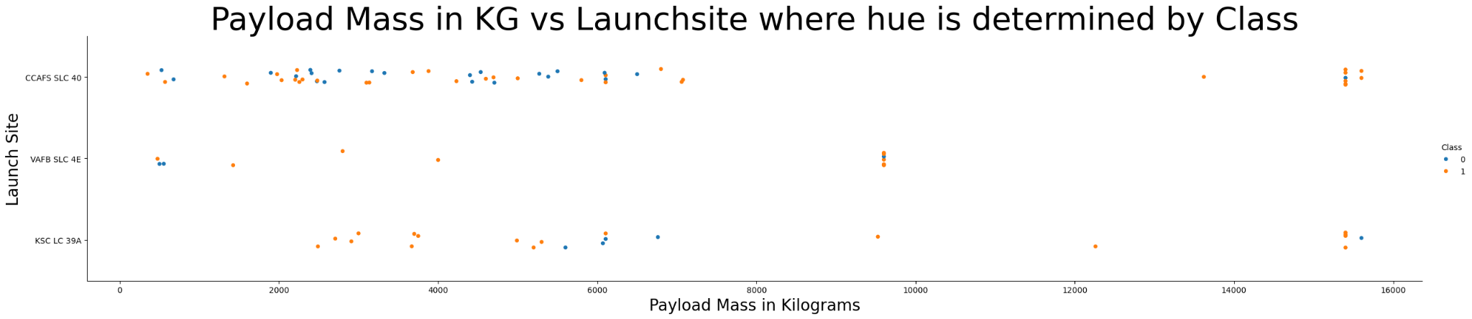
Payload vs. Launch Site
The greater the payload mass, the higher success rate, even at the outlier values.

Slide 20
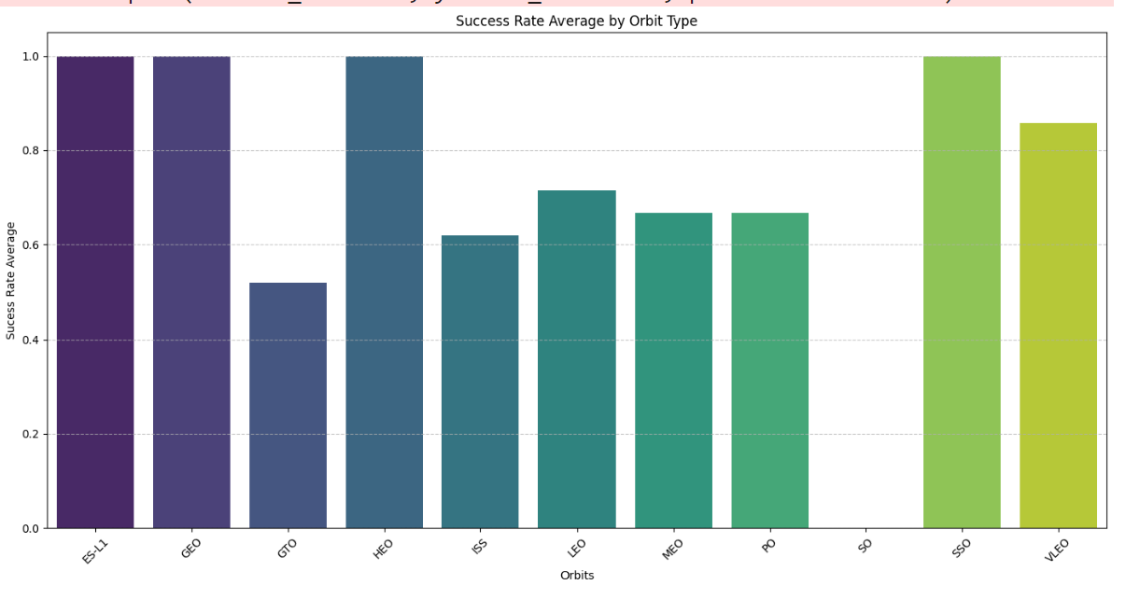
Success Rate vs. Orbit Type
Most successful orbits were:
ES-L1
GEO
HEO
SSO
VLEO

Slide 21
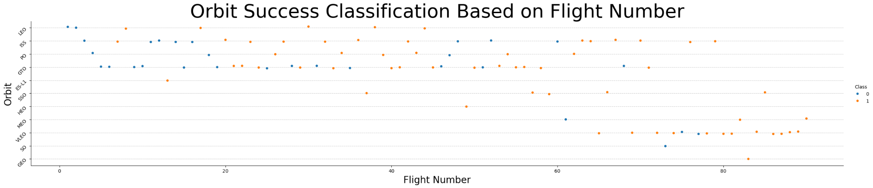
Flight Number vs. Orbit Type
Success is related to the number of flights whereas in the GTO orbit, there is no relationship between flight number and the orbit.

Slide 22
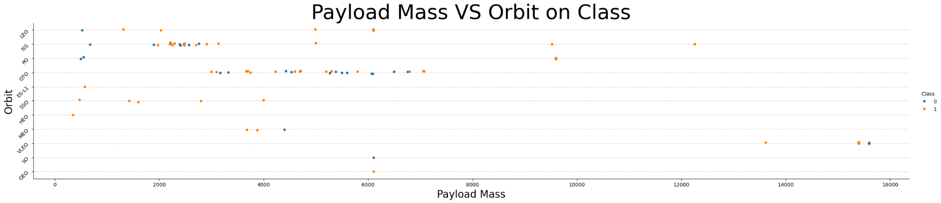
Payload vs. Orbit Type
Heavy Payloads, the successful landings are associated heavily with LEO, PO, and ISS orbits.

Slide 23
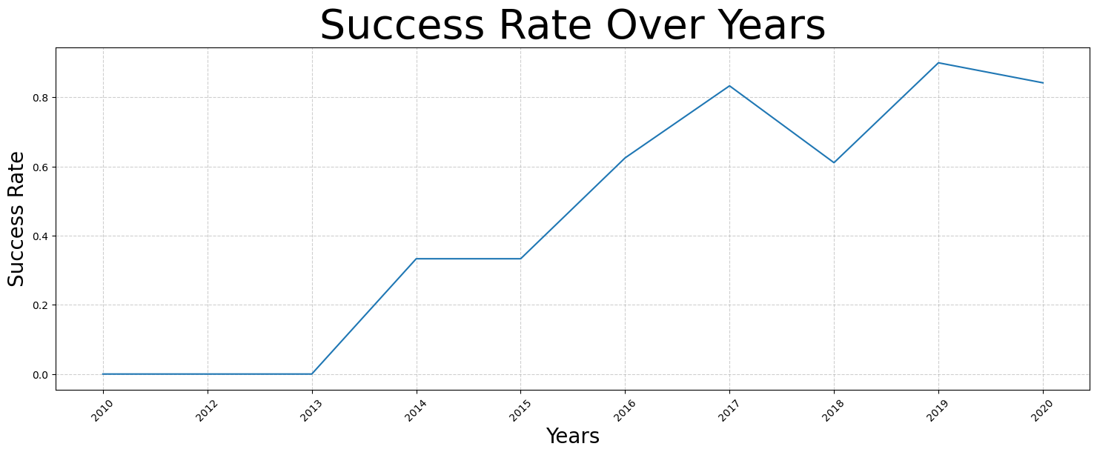
Launch Success Yearly Trend
Success rate since 2013 kept increasing with a small crash in 2018 until 2020.

Slide 24
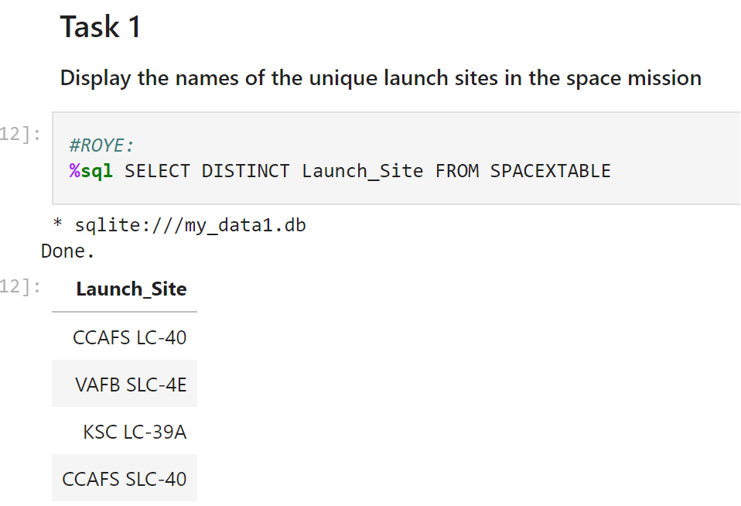
All Launch Site Names
We used the keyword DISTINCT to show only unique launch sites from the SpaceX data.

Slide 25
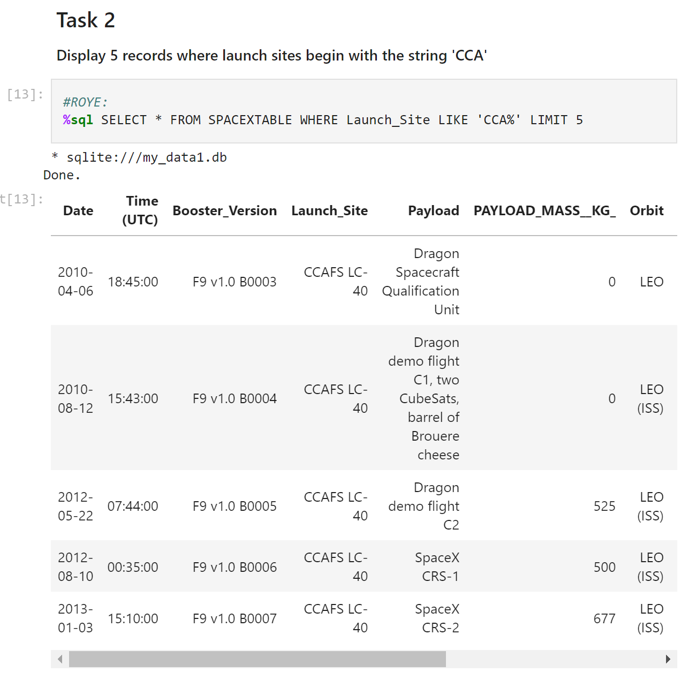
Launch Site Names Begin with 'CCA'
Used the simple query with a string lookup to display top five records with the matching string.

Slide 26
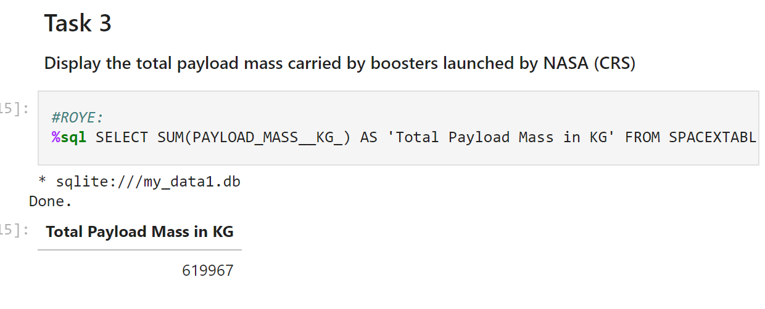
Total Payload Mass
Calculated total payload carried by boosters from NASA using the LIKE keyword.

Slide 27
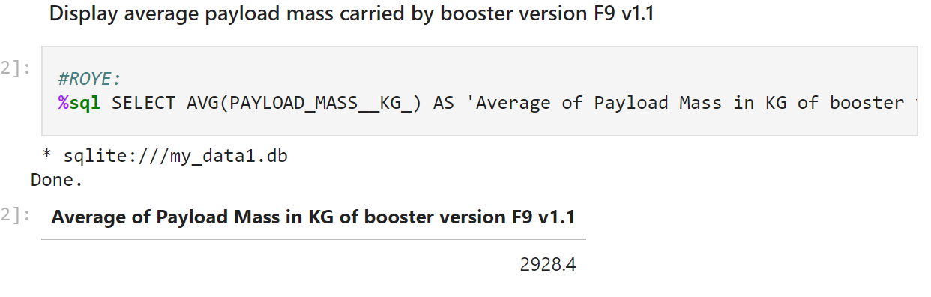
Average Payload Mass by F9 v1.1
Used the avg method in sql to present the following result:

Slide 28
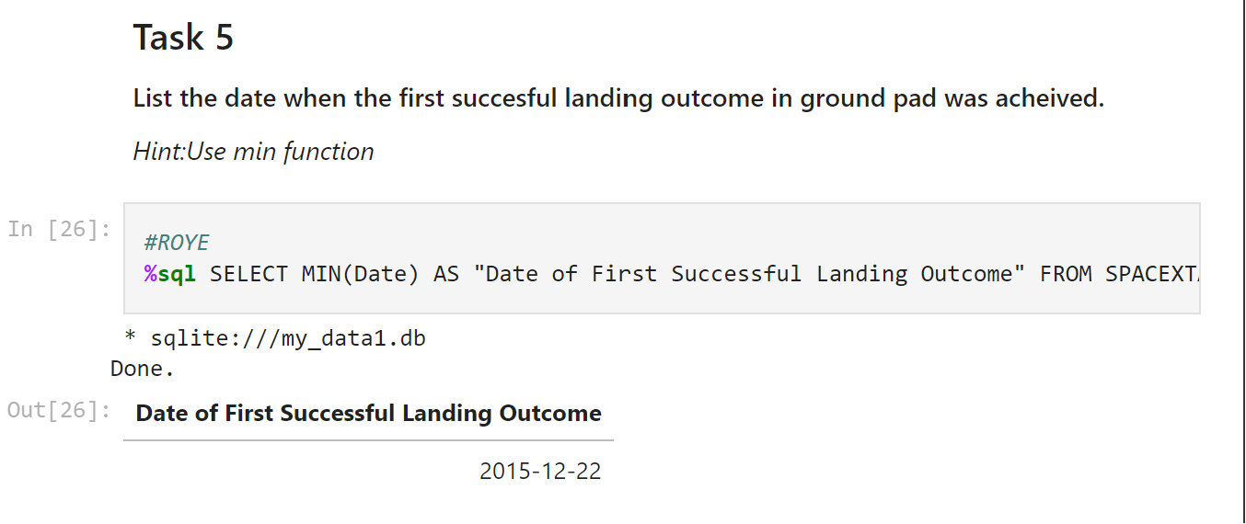
First Successful Ground Landing Date
Use the Min() method in SQL to display the first Successful ground landing date from the edited dataframe:

Slide 29
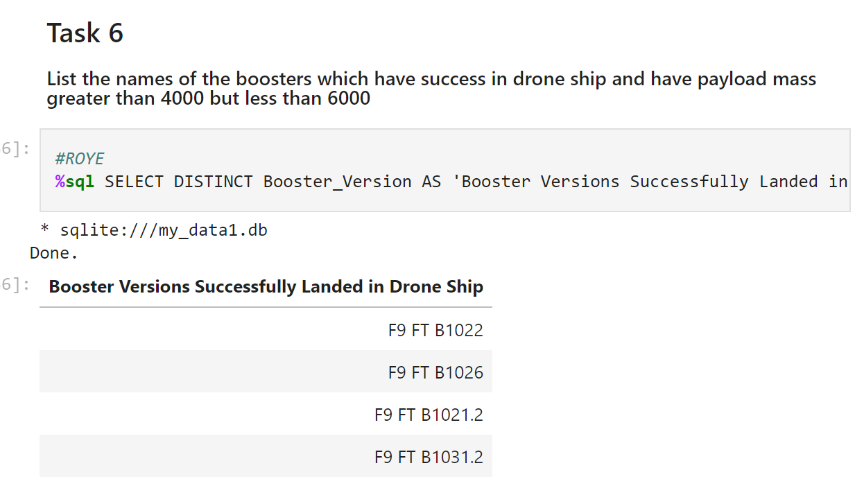
Successful Drone Ship Landing with Payload between 4000 and 6000
Uses DISTINCT and WHERE keywords along with a subquery to determine success between certain payload sizes:

Slide 30
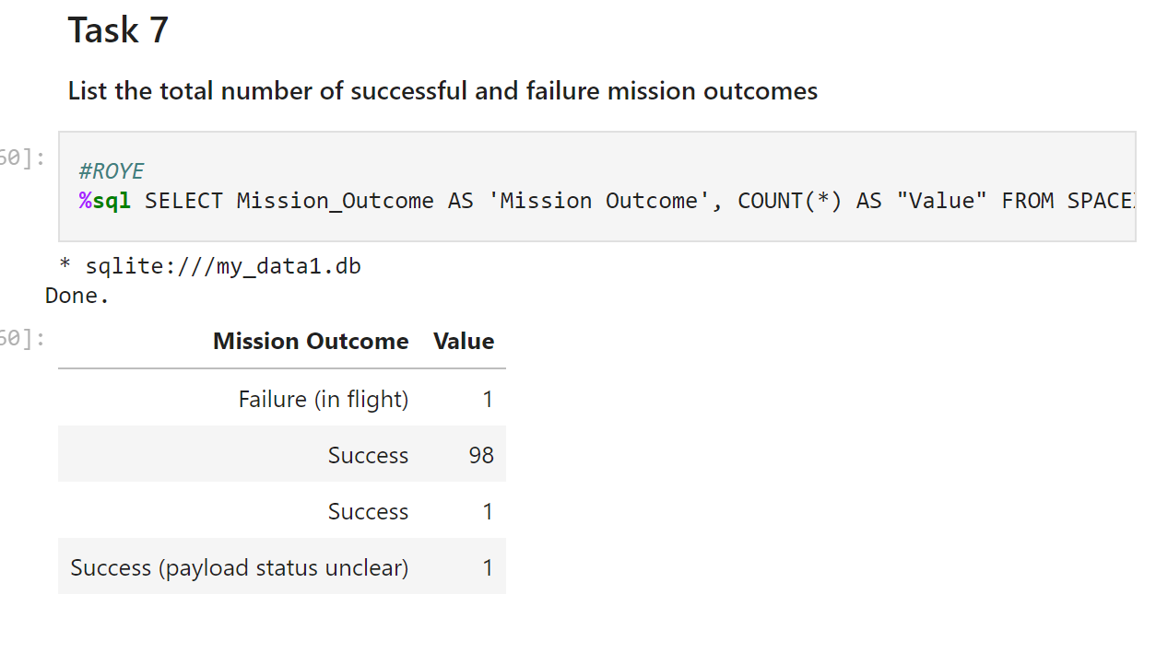
Total Number of Successful and Failure Mission Outcomes

Slide 31
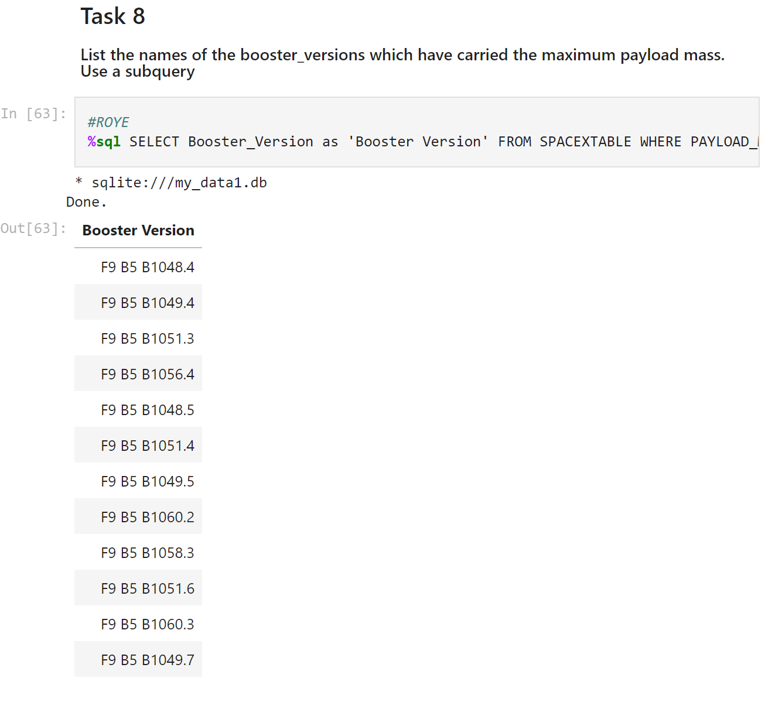
Boosters Carried Maximum Payload
Used wildcard ‘%’ filtering WHERE keyword on success or failure:

Slide 32
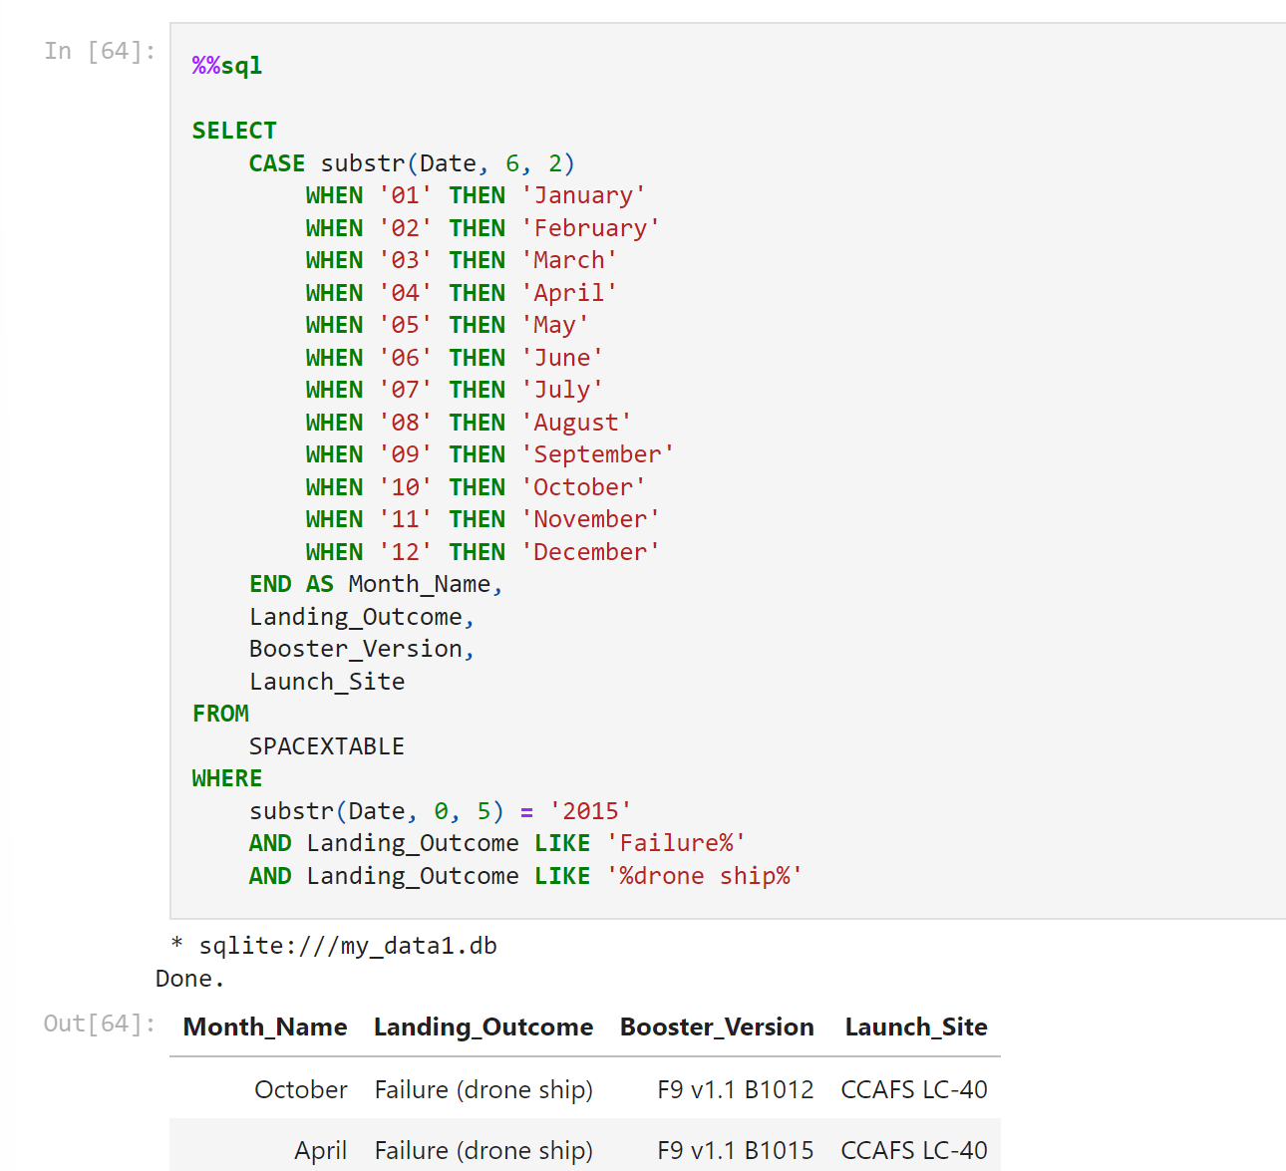
2015 Launch Records
Created a substr with new dates to classify things through SQL to determine max payload through a subquery and WHERE/MAX fn’s/keywords:

Slide 33
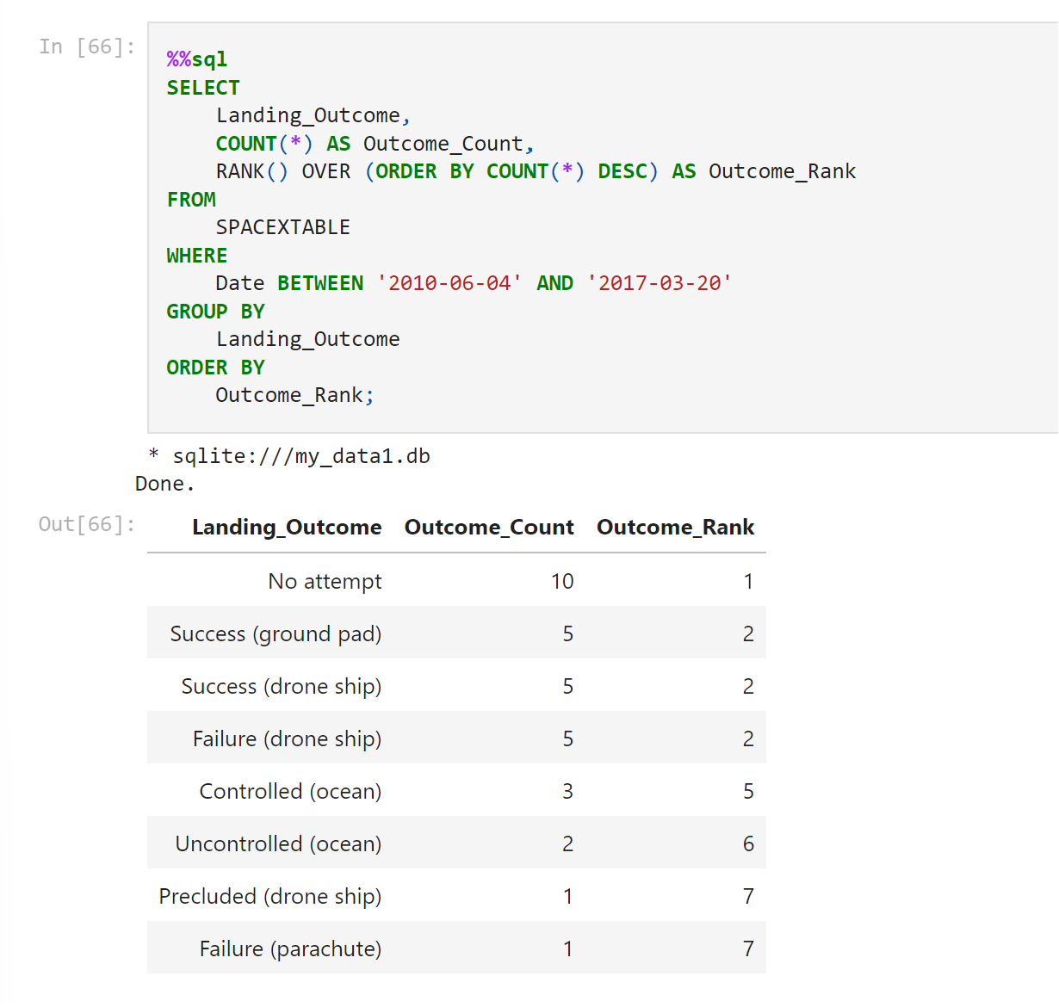
Rank Landing Outcomes Between 2010-06-04 and 2017-03-20
Using COUNT, RANK() with and ORDER BY COUNT subquery: managed to rank outcomes:

Slide 34

Section 3

Slide 35
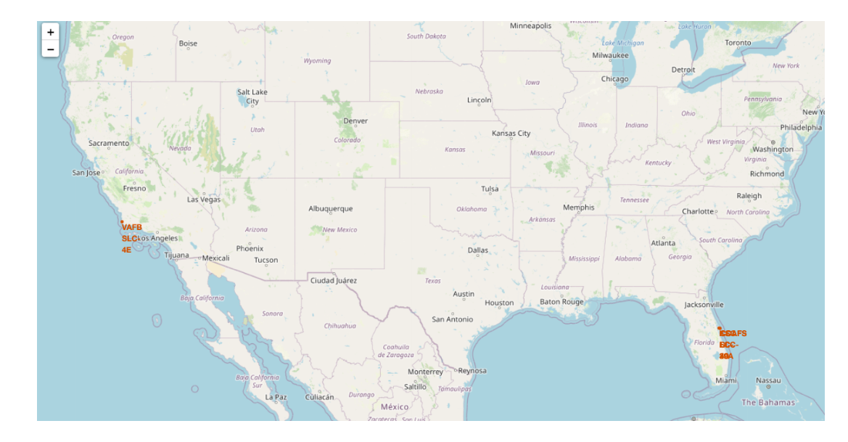
All National Map Markers
Shows a marker of where the space stations are (CA and FL)

Slide 36

Markers Showing Launch Sites with Color Labels
Green Markers show successful launches and red shows failures

Slide 37

Launch Site Distance to Landmarks
Also an example of lines drawn to show distance of coastline, landmarks, and highways in the lab:

Slide 38

Section 4

Slide 39
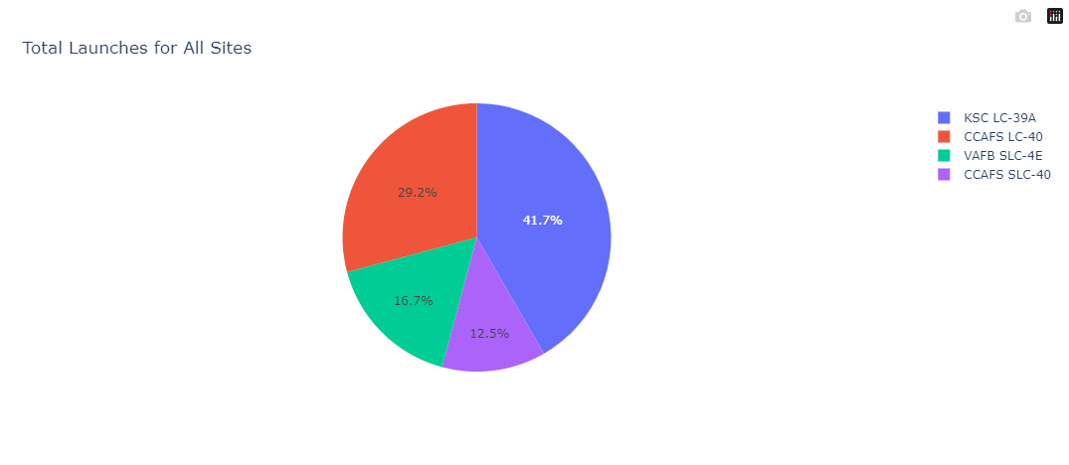
Pie Chart of Total Success Launches

Slide 40
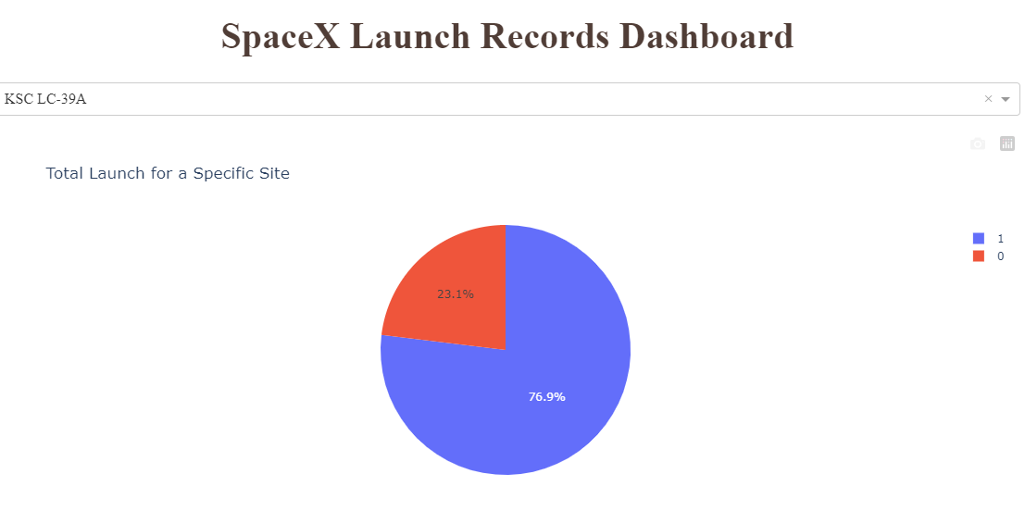
Launch Site with Highest Success Rate

Slide 41
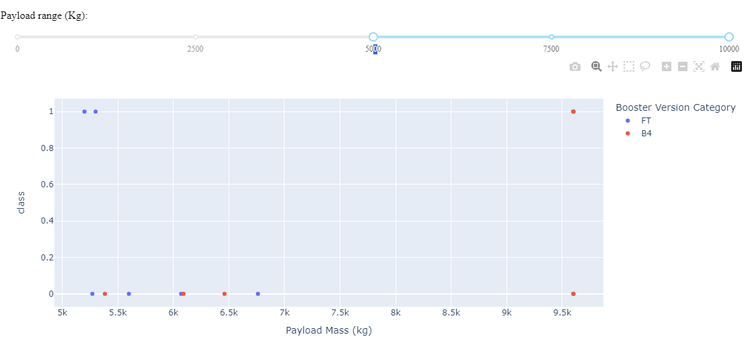
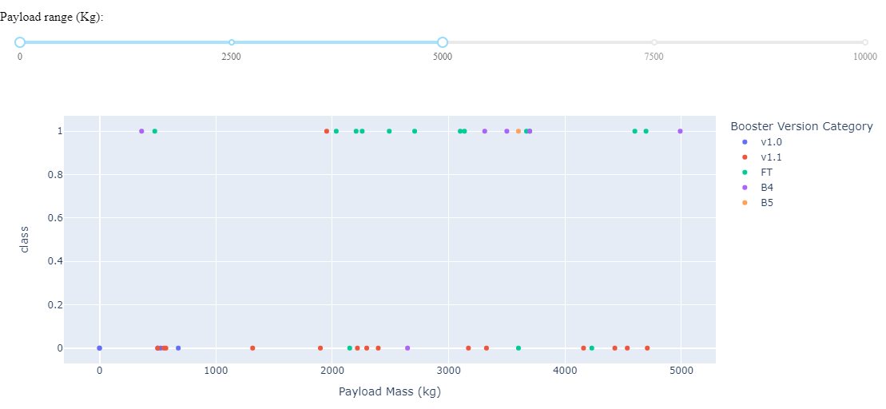
Payload Range of all Launch Outcomes using a Slider
5-10kg
1-5kg

Slide 42

Section 5

Slide 43
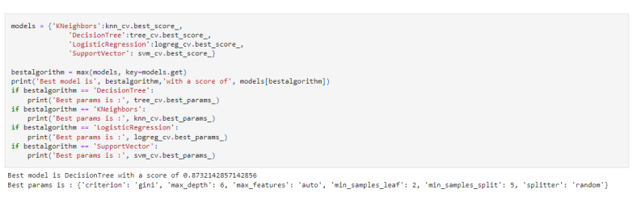
Classification Accuracy

Slide 44
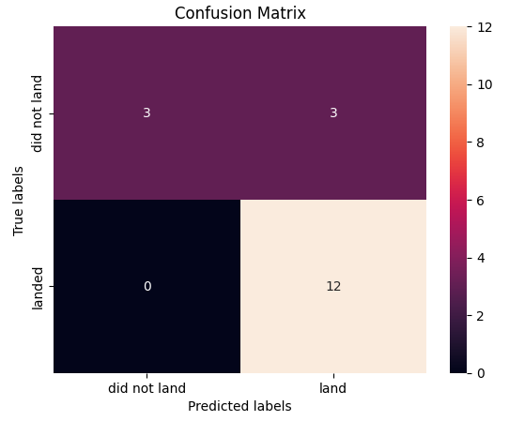
Confusion Matrix
Only major problem is false positives by the confusion Matrix. But it shows that the decision tree classifier can distinguish between different classes.

Slide 45
Conclusions
Larger the flight amount at the same sight, the better chances of it successfully landing due to improvements made
Launch Success rate has overall been successful and has only increased from 2013-2020
KSC LC-39A had the most successful launches.
5/9 orbits roughly had around the same success rate and were pretty high (ES-L1, GEO, HEO, SSO, VLEO)
Decision Tree Classifier was the best machine learning algorithm for predictive behavior due to most of our observations and predictions being related to binary values (whether a launch was successful or not).

Slide 46


